Slide 1


UFO Sightings
Team Tenacious:
Abi Chambers
Alejandro Perez
Carlos De La Rosa
Ann Ly

Slide 2
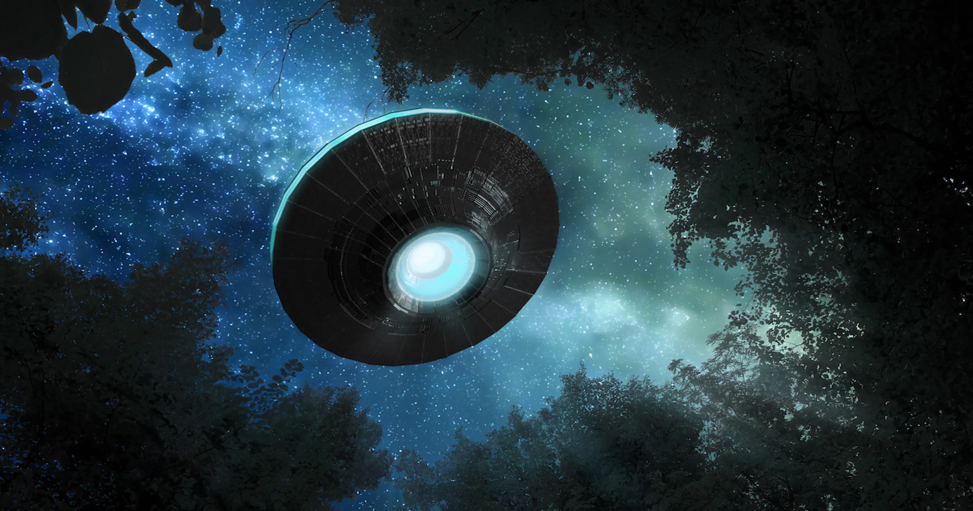
PROJECT PROPOSAL:
UFO Sightings in the United States

Slide 3
DATASET
https://www.kaggle.com/datasets/camnugent/ufo-sightings-around-the-world
We chose a dataset that we could have fun with, but also keep in our portfolios and freely share with a potential employer.

Slide 4
INSPIRATION
The most popular codes on Kaggle used that data in correspondence with meteorite landings and releases of popular movies. Most EDA’s closely resemble the type of analysis that we have done (locations, trends across year, types of UFO shapes).

Slide 5
RESEARCH QUESTIONS
Are there trends in the locations of sightings?
If so, do those trends extend to UFO shapes sighted, or length of the encounter?
Is there any significant relationship between sightings and particular times or dates?
Are there any changes in sighting frequency or locations over time?

Slide 6
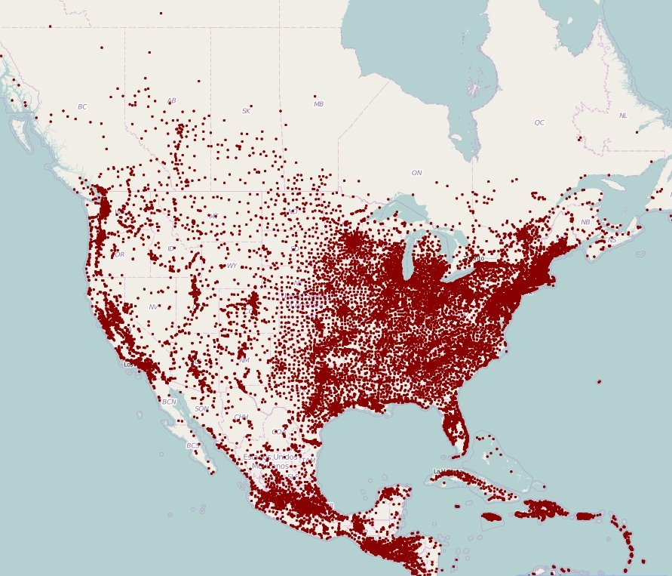
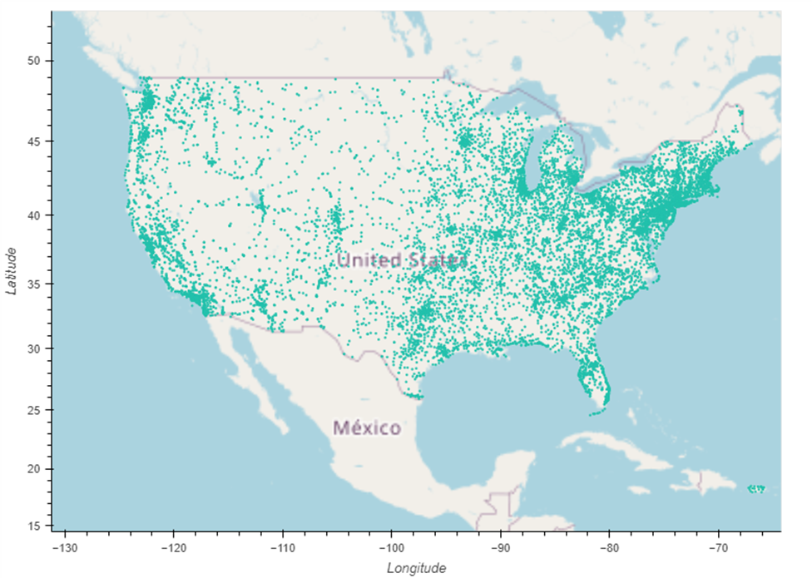

Slide 14
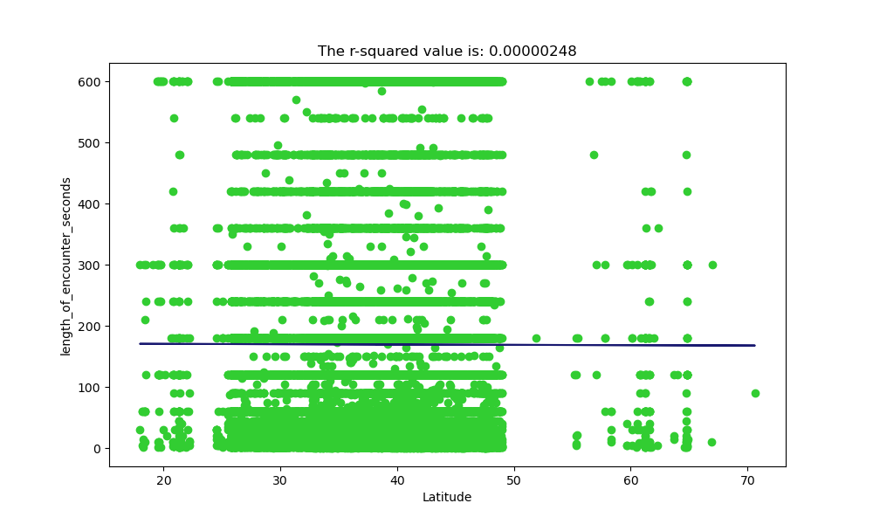
Regression
This is a scatter plot between length of encounters vs. the Latitude. The r2 value turned out to be .00000248 which means there is zero (0) correlation between the latitude and the encounter time.

Slide 15
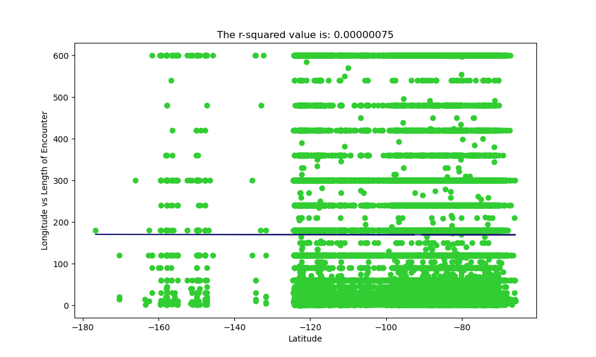
This is a scatterplot between Longitude vs. Length of Encounters

Slide 17

Color Palette

Slide 18
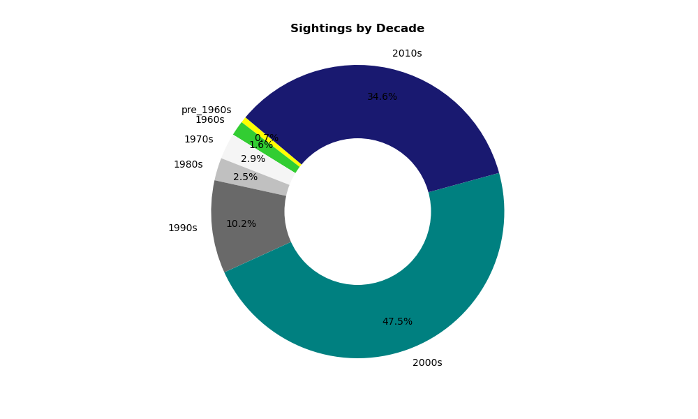

Slide 19
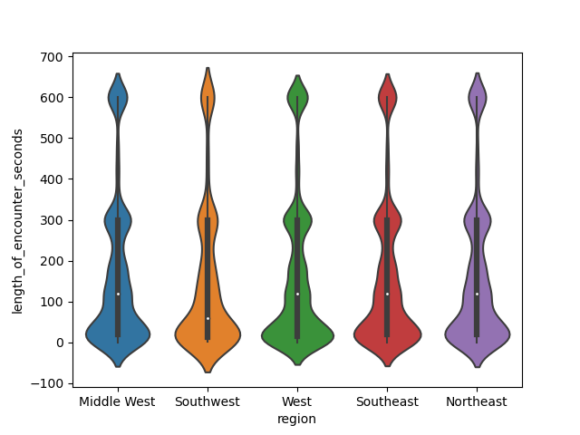

Slide 20
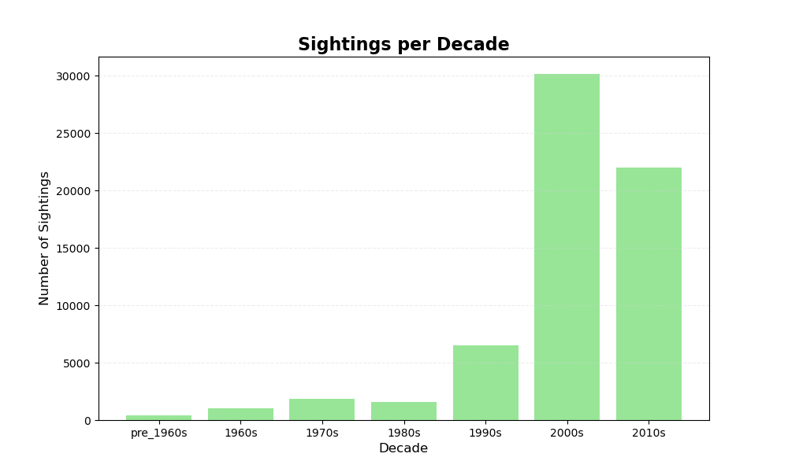

Slide 22
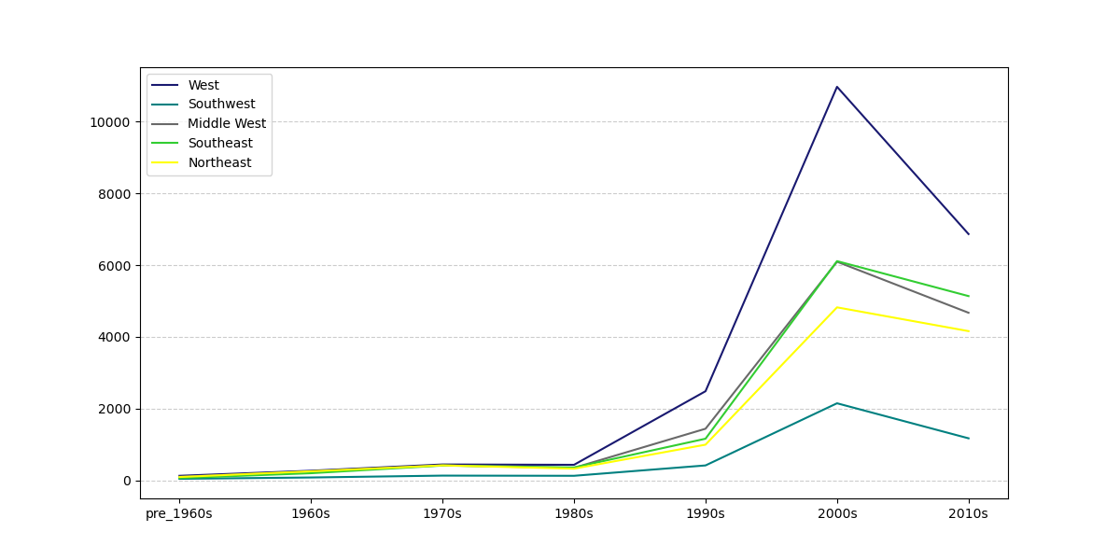

Slide 23
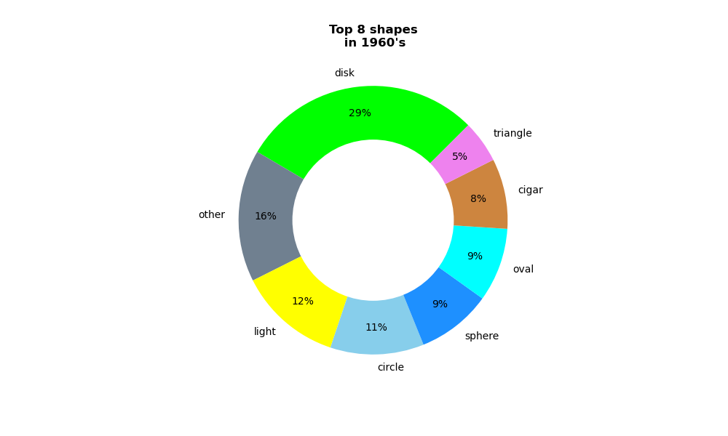
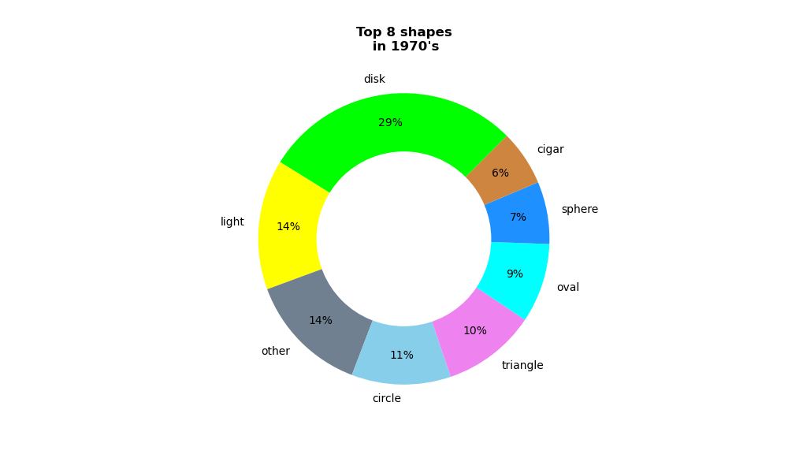
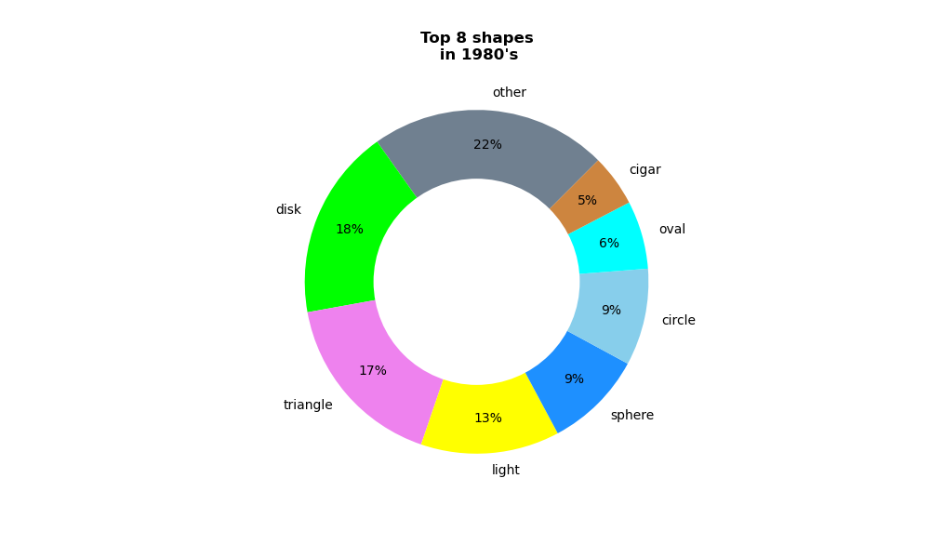
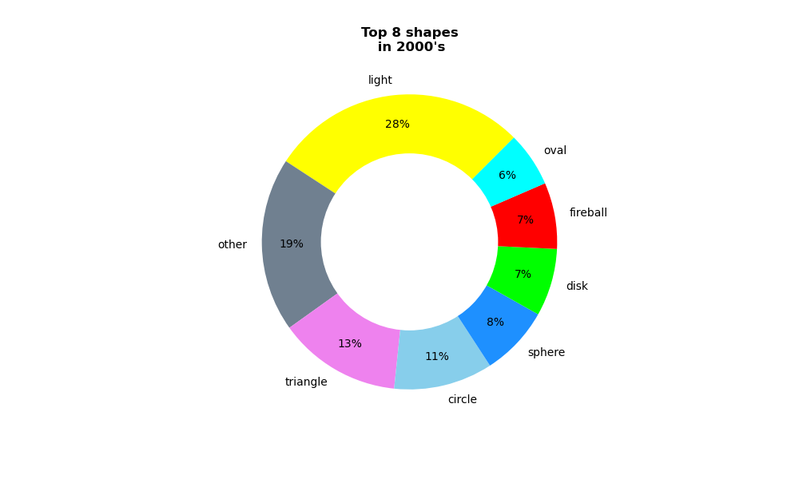
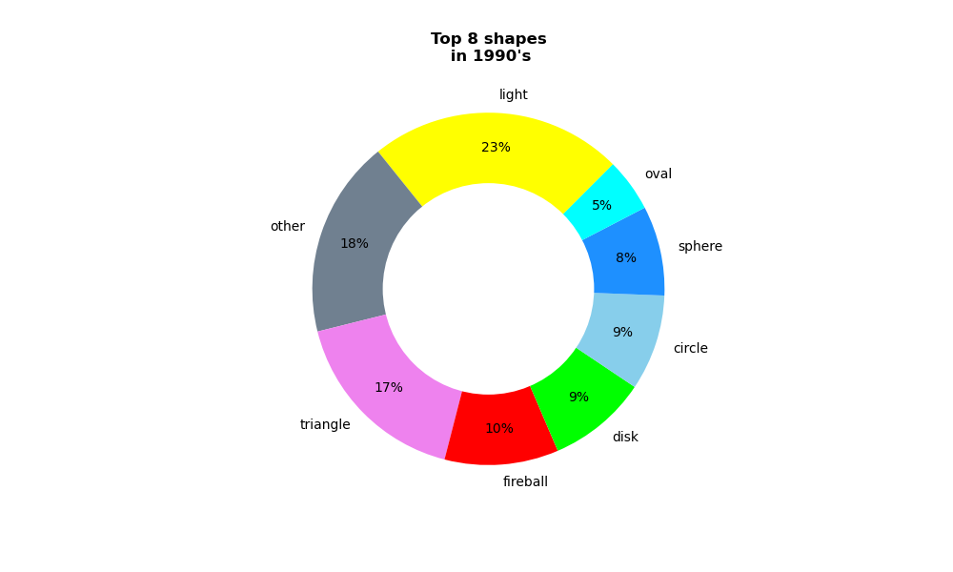
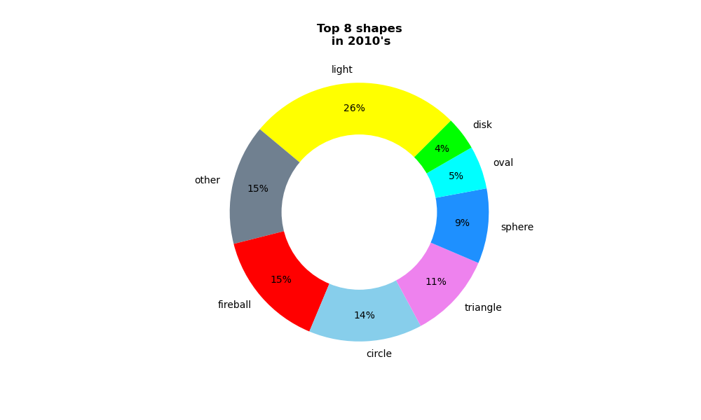

Slide 24
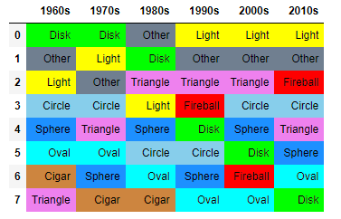

Slide 25
